Slide 1

Speech to Text
Motolani Alimi

Slide 2
Improving Speech to text quality of audio
When It comes to the quality of speech, accuracy is very important. The speech’s accuracy is affected by the noise level. Let’s look at this closely
Actual Phrase: I am walking
Actual Transcribed Phrase: I am walking with noise reduced as much as possible
With great level of noise then the transcribed phrase: I am working
I am looking at different noisy audio files, birds, typing on the keyboard, and casino

Slide 3
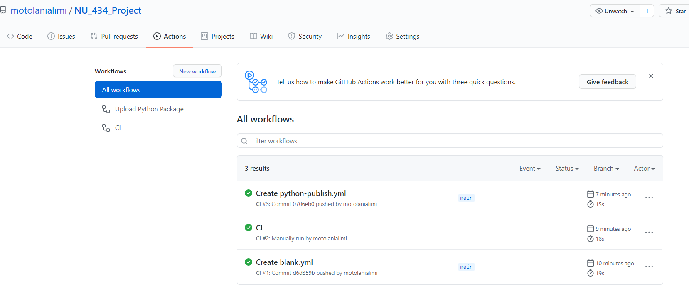
Created a CI on GitHub

Slide 4
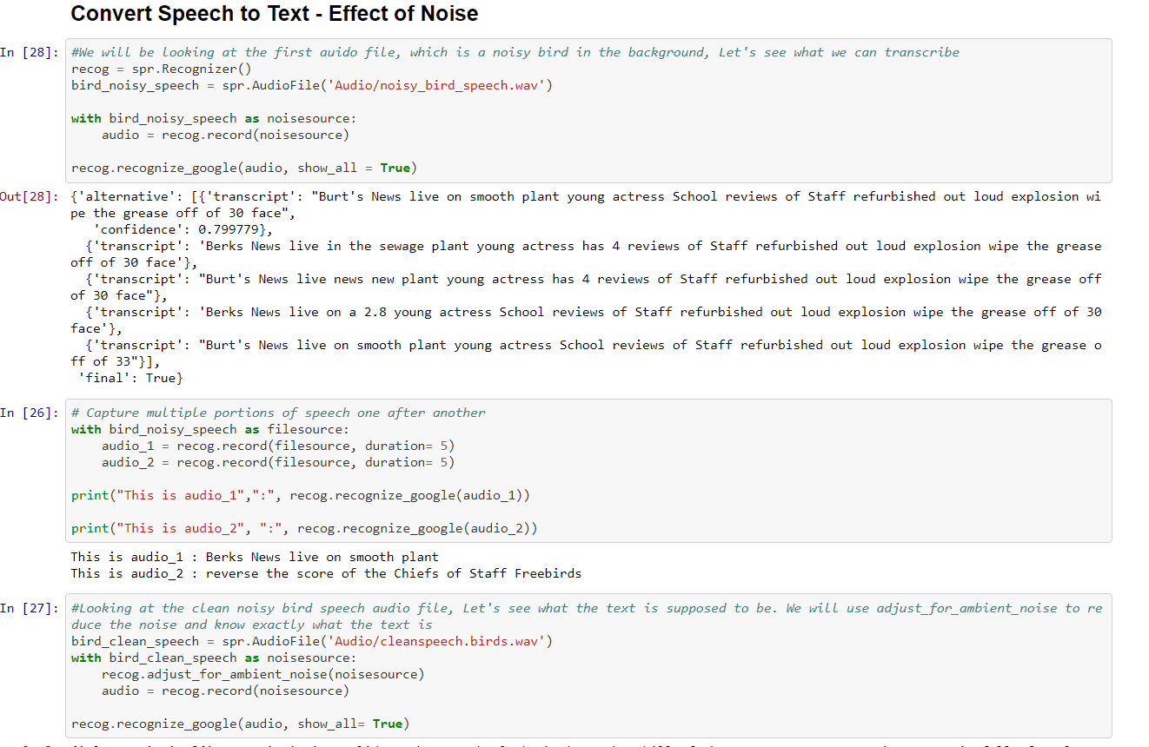
Workbook

